Slide 1
CHAPTER 6:
SQL: Overview
SQL Overview
© Pearson Education Limited 1995, 2005
Notes:
Chapter Name
September 98

Slide 2
Writing SQL Commands
SQL statement consists of reserved words and user-defined words.
Reserved words are a fixed part of SQL and must be spelt exactly as required and cannot be split across lines.
User-defined words are made up by user and represent names of various database objects such as relations, columns, views.
© Pearson Education Limited 1995, 2005

Slide 3
Writing SQL Commands
Most components of an SQL statement are case insensitive, except for literal character data.
More readable with indentation and lineation:
  Each clause should begin on a new line.
  Start of a clause should line up with start of other clauses.
  If clause has several parts, should each appear on a separate line and be indented under start of clause.
© Pearson Education Limited 1995, 2005

Slide 4
Literals
Literals are constants used in SQL statements.
All non-numeric literals must be enclosed in single quotes (e.g. ‘London’).
All numeric literals must not be enclosed in quotes (e.g. 650.00).
© Pearson Education Limited 1995, 2005

Slide 5
SELECT Statement
  SELECT [DISTINCT | ALL]
  {* | [columnExpression [AS newName]] [,...] }
  FROM TableName [alias] [, ...]
  [WHERE condition]
  [GROUP BY columnList] [HAVING condition]
  [ORDER BY columnList]
© Pearson Education Limited 1995, 2005

Slide 6
SELECT Statement
FROM Specifies table(s) to be used.
WHERE Filters rows.
GROUP BY Forms groups of rows with same
  column value.
HAVING Filters groups subject to some
  condition.
SELECT Specifies which columns are to
  appear in output.
ORDER BY Specifies the order of the output.
© Pearson Education Limited 1995, 2005

Slide 7
SELECT Statement
Order of the clauses cannot be changed.
Only SELECT and FROM are mandatory.
© Pearson Education Limited 1995, 2005

Slide 8
Example 5.1 All Columns, All Rows
List full details of all staff.
SELECT staffNo, fName, lName, address,
  position, sex, DOB, salary, branchNo
  FROM Staff;
Can use * as an abbreviation for ‘all columns’:
  SELECT *
  FROM Staff;
© Pearson Education Limited 1995, 2005

Slide 9
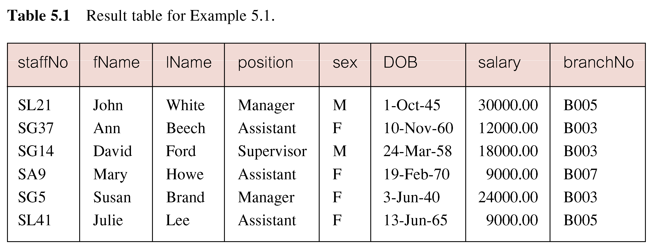
Example 5.1 All Columns, All Rows
© Pearson Education Limited 1995, 2005

Slide 10
Example 5.2 Specific Columns, All Rows
Produce a list of salaries for all staff, showing only staff number, first and last names, and salary.
  SELECT staffNo, fName, lName, salary
  FROM Staff;
© Pearson Education Limited 1995, 2005

Slide 11
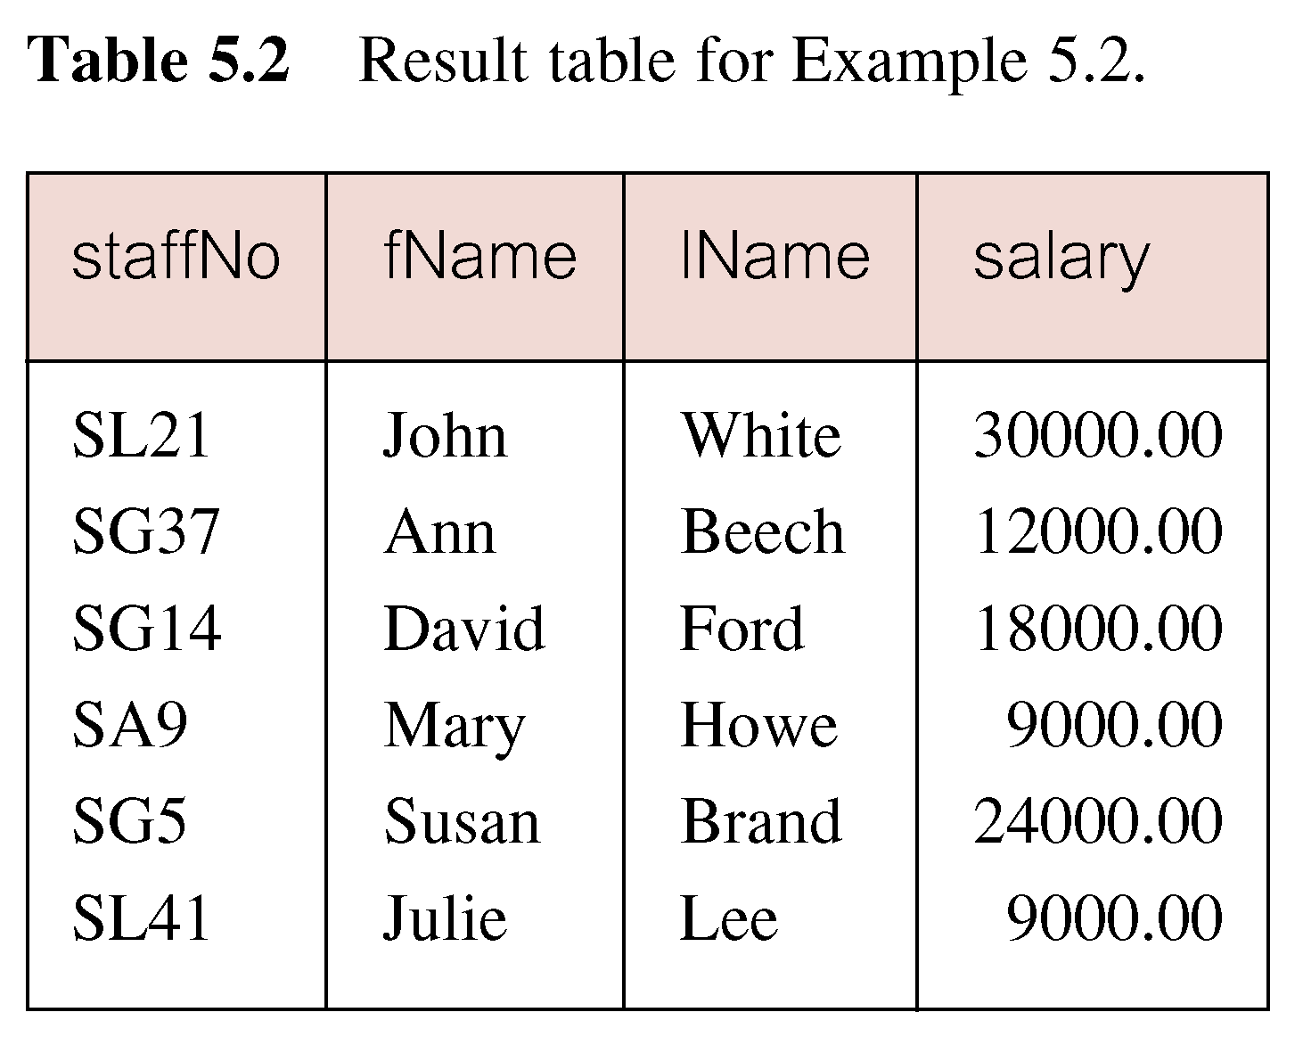
Example 5.2 Specific Columns, All Rows
© Pearson Education Limited 1995, 2005

Slide 12

Example 5.3 Use of DISTINCT
List the property numbers of all properties that have been viewed.
SELECT propertyNo
  FROM Viewing;
© Pearson Education Limited 1995, 2005

Slide 13
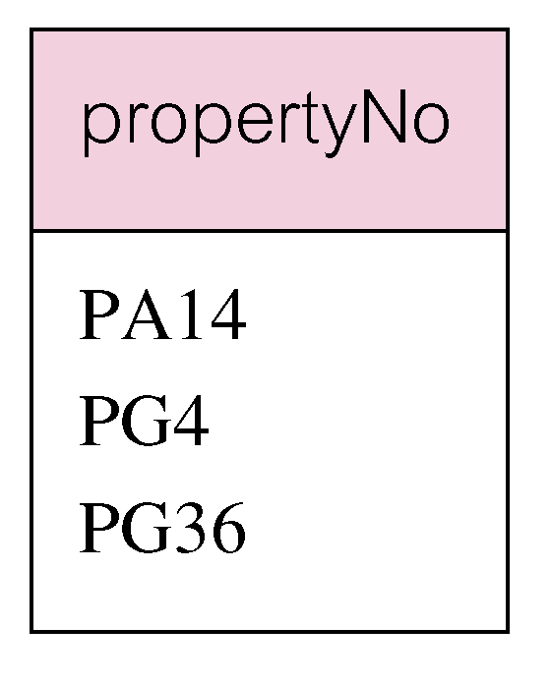
Example 5.3 Use of DISTINCT
Use DISTINCT to eliminate duplicates:
SELECT DISTINCT propertyNo
  FROM Viewing;
© Pearson Education Limited 1995, 2005

Slide 14
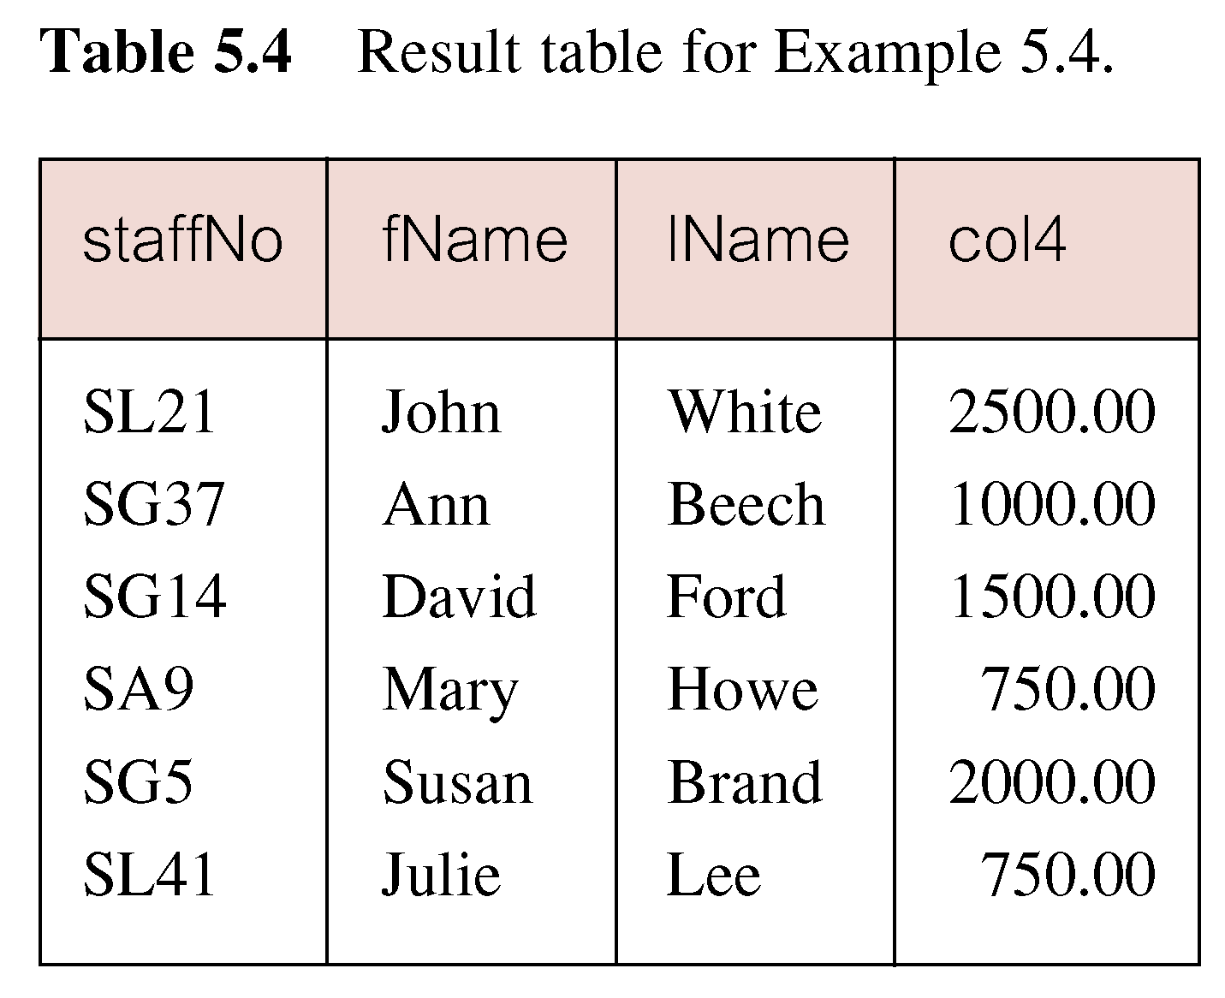
Example 5.4 Calculated Fields
Produce list of monthly salaries for all staff, showing staff number, first/last name, and salary.
SELECT staffNo, fName, lName, salary/12
  FROM Staff;
© Pearson Education Limited 1995, 2005

Slide 15
Example 5.4 Calculated Fields
To name column, use AS clause:
SELECT staffNo, fName, lName, salary/12
  AS monthlySalary
  FROM Staff;
© Pearson Education Limited 1995, 2005

Slide 16
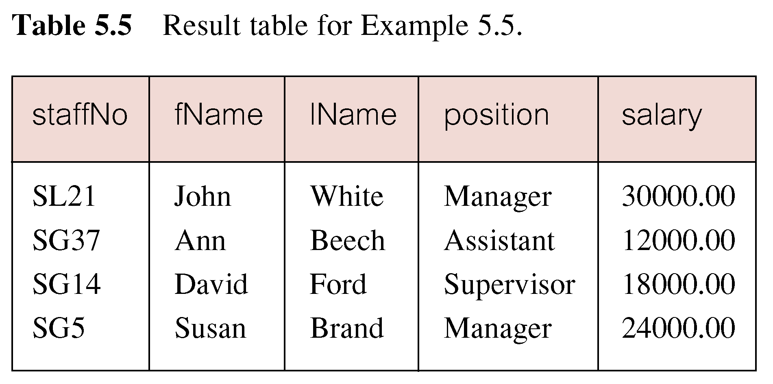
Example 5.5 Comparison Search Condition
List all staff with a salary greater than 10,000.
SELECT staffNo, fName, lName, position, salary
  FROM Staff
  WHERE salary > 10000;
© Pearson Education Limited 1995, 2005

Slide 17
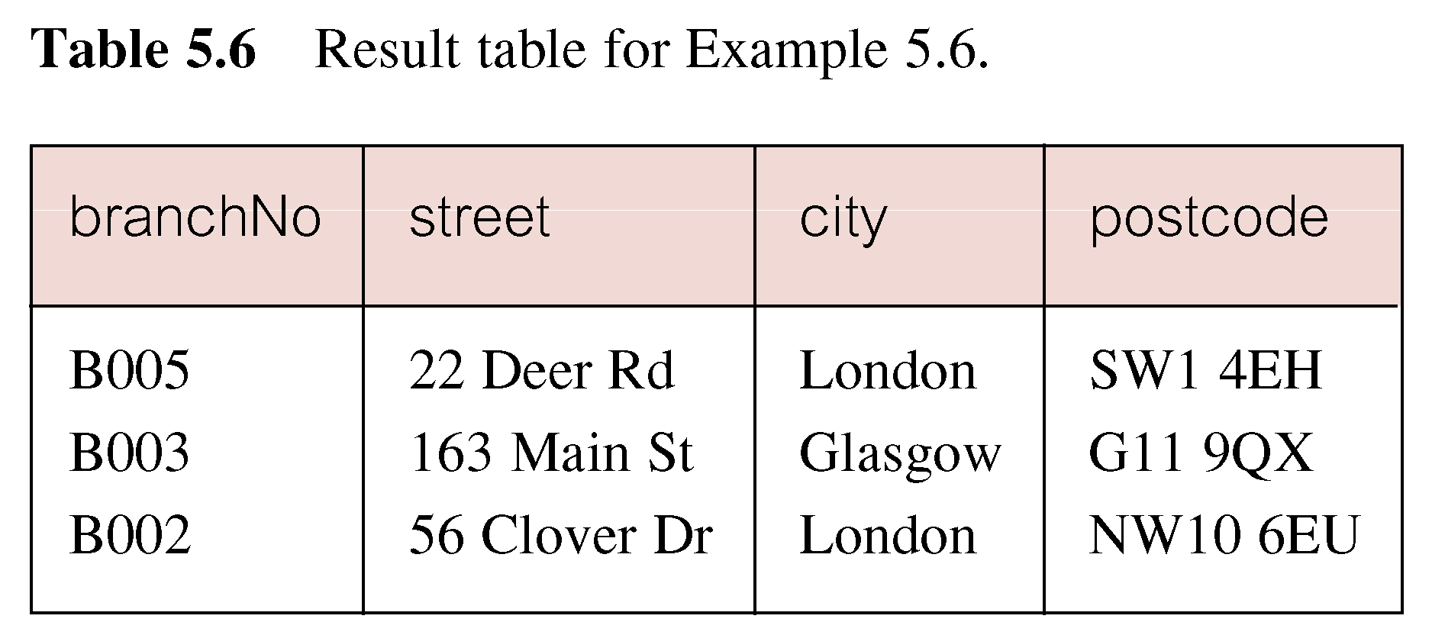
Example 5.6 Compound Comparison Search Condition
List addresses of all branch offices in London or Glasgow.
SELECT *
  FROM Branch
  WHERE city = ‘London’ OR city = ‘Glasgow’;
© Pearson Education Limited 1995, 2005

Slide 18
Example 5.7 Range Search Condition
List all staff with a salary between 20,000 and 30,000.
SELECT staffNo, fName, lName, position, salary
  FROM Staff
  WHERE salary BETWEEN 20000 AND 30000;
BETWEEN test includes the endpoints of range.
© Pearson Education Limited 1995, 2005

Slide 19
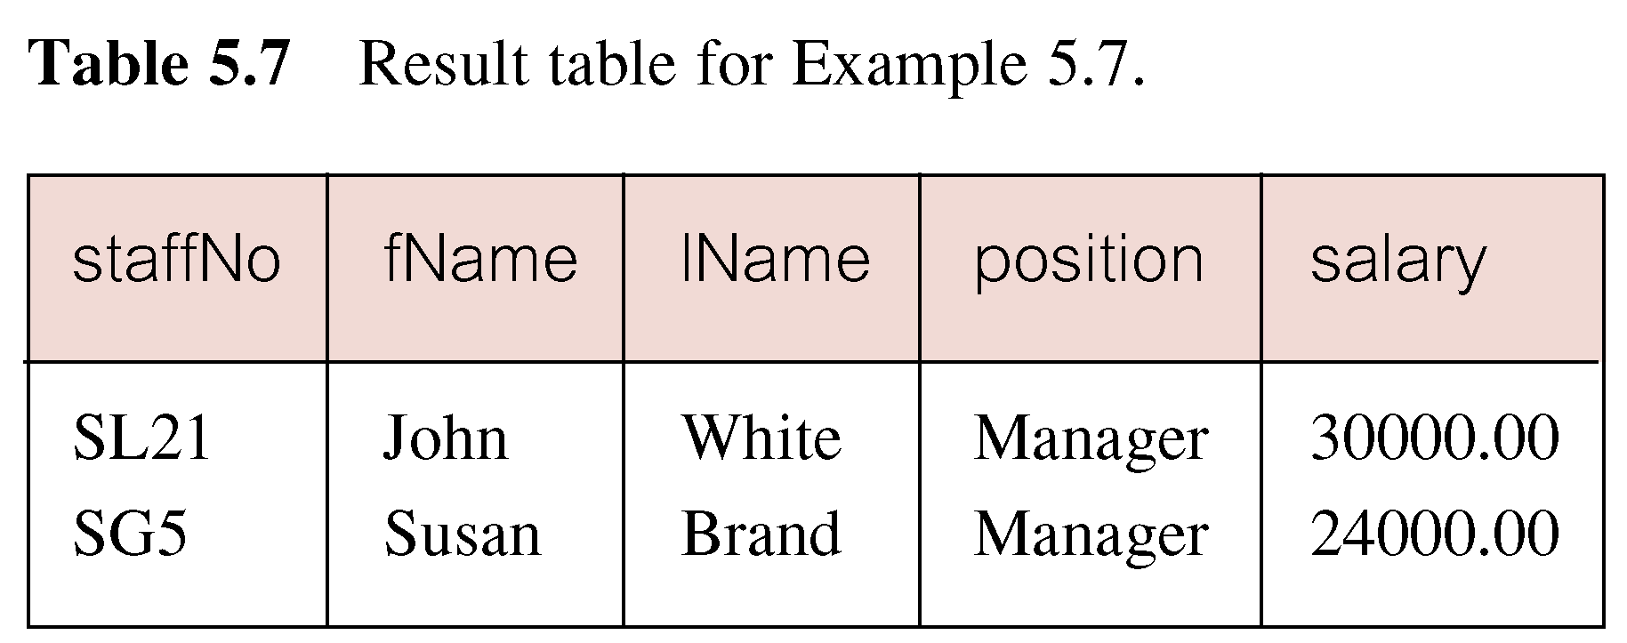
Example 5.7 Range Search Condition
© Pearson Education Limited 1995, 2005

Slide 20
Example 5.7 Range Search Condition
Also a negated version NOT BETWEEN.
BETWEEN does not add much to SQL’s expressive power. Could also write:
SELECT staffNo, fName, lName, position, salary
  FROM Staff
  WHERE salary>=20000 AND salary <= 30000;
Useful, though, for a range of values.
© Pearson Education Limited 1995, 2005

Slide 21
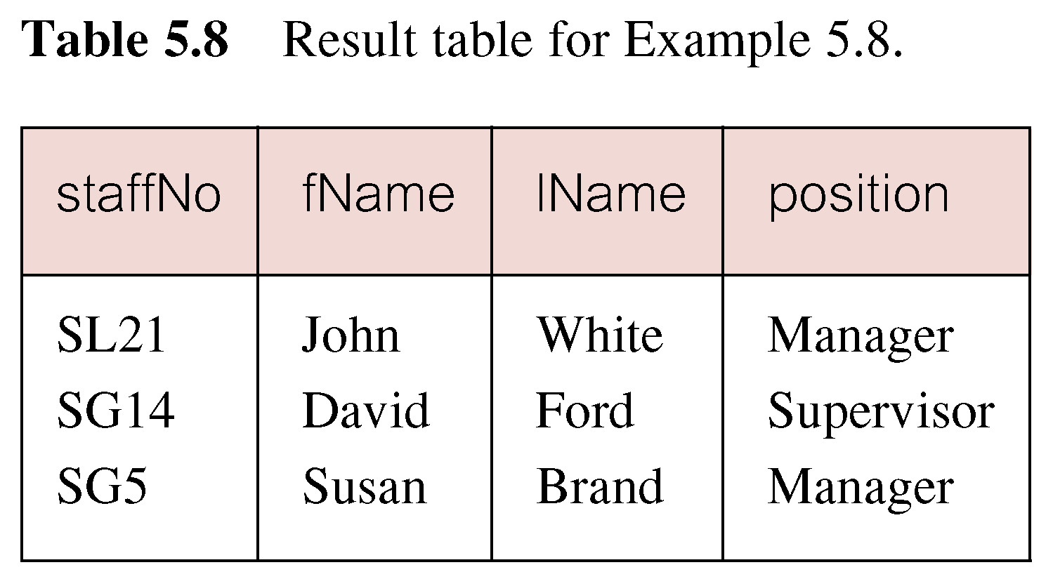
Example 5.8 Set Membership
List all managers and supervisors.
  SELECT staffNo, fName, lName, position
  FROM Staff
  WHERE position IN (‘Manager’, ‘Supervisor’);
© Pearson Education Limited 1995, 2005

Slide 22
Example 5.8 Set Membership
There is a negated version (NOT IN).
IN does not add much to SQL’s expressive power. Could have expressed this as:
  SELECT staffNo, fName, lName, position
  FROM Staff
  WHERE position=‘Manager’ OR
  position=‘Supervisor’;
IN is more efficient when set contains many values.
© Pearson Education Limited 1995, 2005

Slide 23
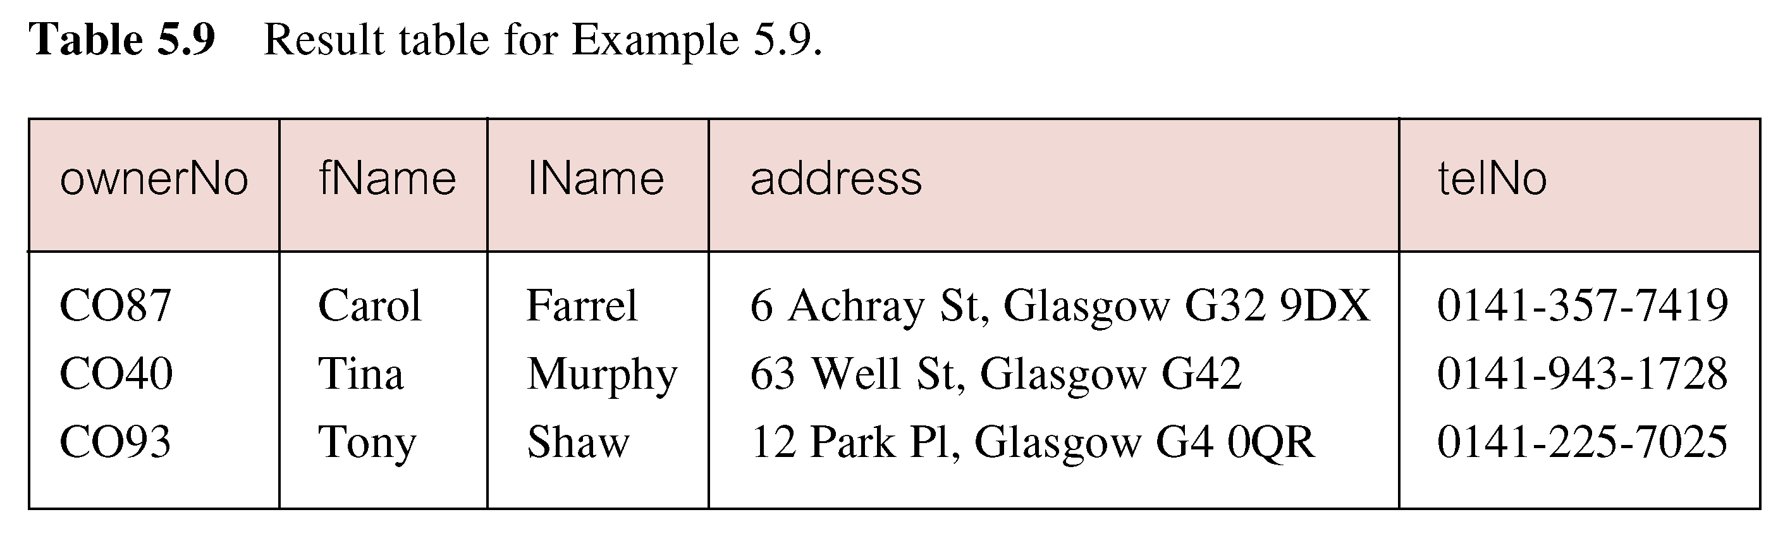
Example 5.9 Pattern Matching
Find all owners with the string ‘Glasgow’ in their address.
SELECT ownerNo, fName, lName, address, telNo
  FROM PrivateOwner
  WHERE address LIKE ‘%Glasgow%’;
© Pearson Education Limited 1995, 2005

Slide 24
Example 5.9 Pattern Matching
SQL has two special pattern matching symbols:
  %: sequence of zero or more characters;
  _ (underscore): any single character.
LIKE ‘%Glasgow%’ means a sequence of characters of any length containing ‘Glasgow’.
© Pearson Education Limited 1995, 2005

Slide 25
Example 5.10 NULL Search Condition
List details of all viewings on property PG4 where a comment has not been supplied.
There are 2 viewings for property PG4, one with and one without a comment.
Have to test for null explicitly using special keyword IS NULL:
SELECT clientNo, viewDate
  FROM Viewing
  WHERE propertyNo = ‘PG4’ AND
  comment IS NULL;
© Pearson Education Limited 1995, 2005

Slide 26
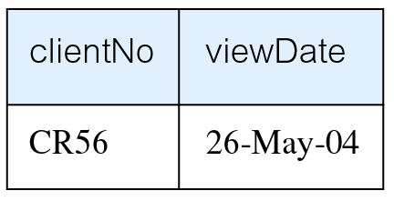
Example 5.10 NULL Search Condition
Negated version (IS NOT NULL) can test for non-null values.
© Pearson Education Limited 1995, 2005

Slide 27
Example 5.11 Single Column Ordering
List salaries for all staff, arranged in descending order of salary.
SELECT staffNo, fName, lName, salary
  FROM Staff
  ORDER BY salary DESC;
© Pearson Education Limited 1995, 2005

Slide 28
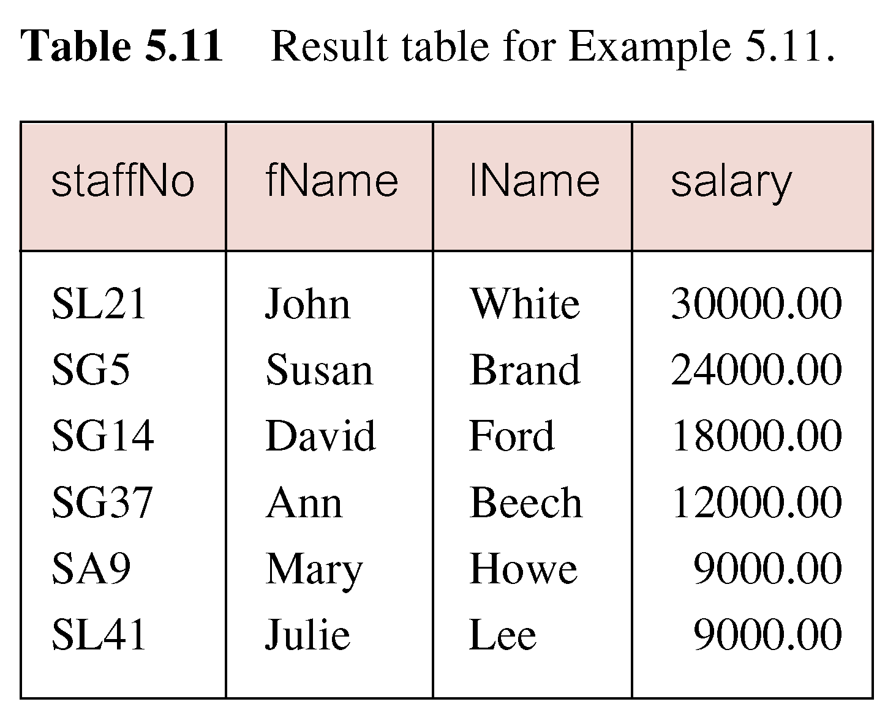
Example 5.11 Single Column Ordering
© Pearson Education Limited 1995, 2005

Slide 29
Example 5.12 Multiple Column Ordering
Produce abbreviated list of properties in order of property type.
SELECT propertyNo, type, rooms, rent
  FROM PropertyForRent
  ORDER BY type;
© Pearson Education Limited 1995, 2005

Slide 30
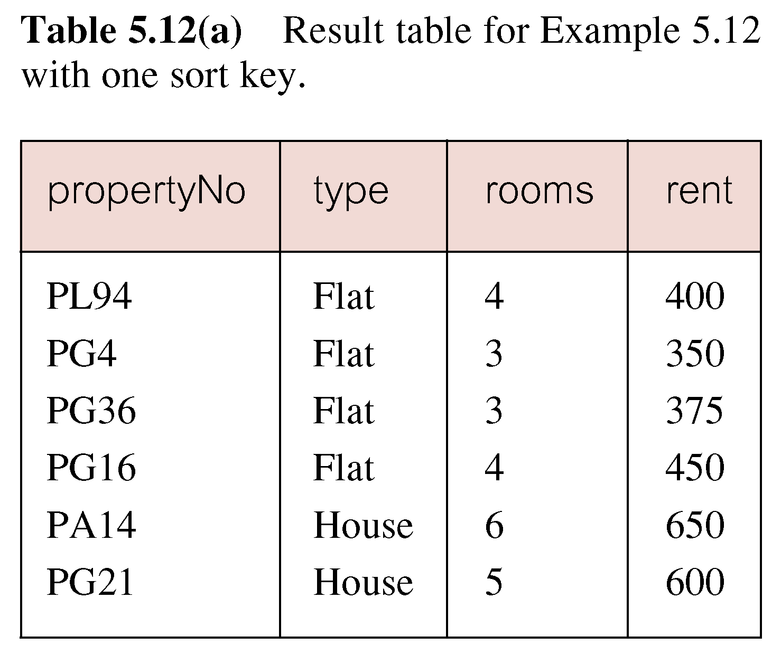
Example 5.12 Multiple Column Ordering
© Pearson Education Limited 1995, 2005

Slide 31
Example 5.12 Multiple Column Ordering
Four flats in this list - as no minor sort key specified, system arranges these rows in any order it chooses.
To arrange in order of rent, specify minor order:
SELECT propertyNo, type, rooms, rent
  FROM PropertyForRent
  ORDER BY type, rent DESC;
© Pearson Education Limited 1995, 2005

Slide 32
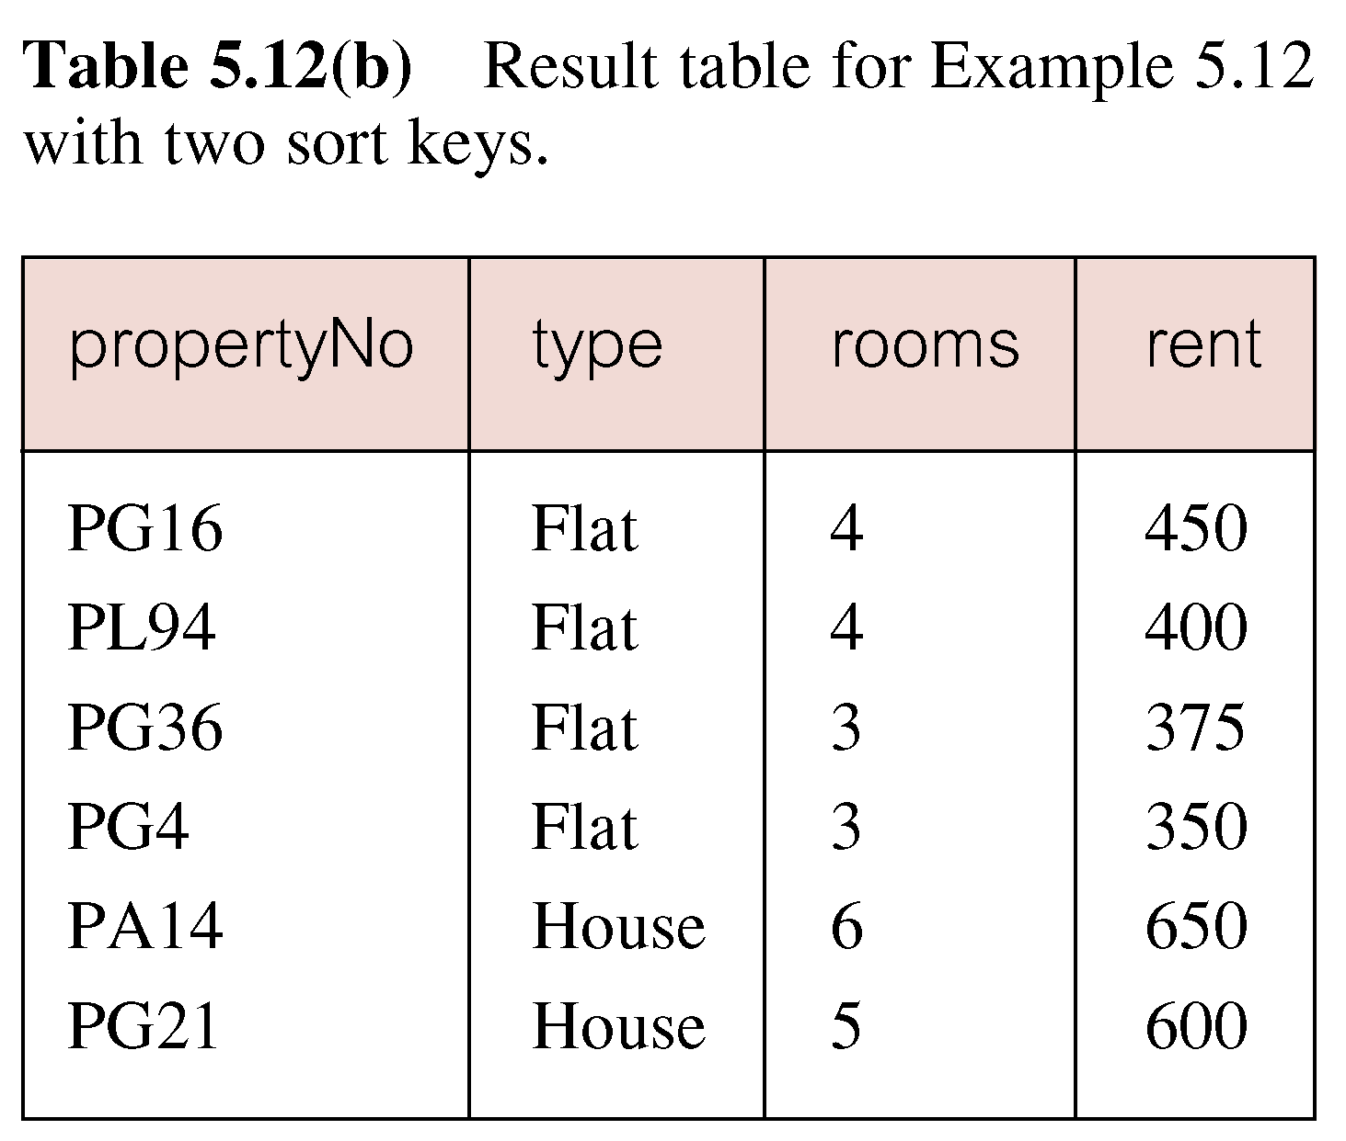
Example 5.12 Multiple Column Ordering
© Pearson Education Limited 1995, 2005

Slide 33
SELECT Statement - Aggregates
ISO standard defines five aggregate functions:
COUNT returns number of values in specified column.
SUM returns sum of values in specified column.
AVG returns average of values in specified column.
MIN returns smallest value in specified column.
MAX returns largest value in specified column.
© Pearson Education Limited 1995, 2005

Slide 34
SELECT Statement - Aggregates
Each operates on a single column of a table and returns a single value.
COUNT, MIN, and MAX apply to numeric and non-numeric fields, but SUM and AVG may be used on numeric fields only.
Apart from COUNT(*), each function eliminates nulls first and operates only on remaining non-null values.
© Pearson Education Limited 1995, 2005

Slide 35
SELECT Statement - Aggregates
COUNT(*) counts all rows of a table, regardless of whether nulls or duplicate values occur.
Can use DISTINCT before column name to eliminate duplicates.
DISTINCT has no effect with MIN/MAX, but may have with SUM/AVG.
© Pearson Education Limited 1995, 2005

Slide 36
SELECT Statement - Aggregates
Aggregate functions can be used only in SELECT list and in HAVING clause.
If SELECT list includes an aggregate function and there is no GROUP BY clause, SELECT list cannot reference a column out with an aggregate function. For example, the following is illegal:
SELECT staffNo, COUNT(salary)
  FROM Staff;
© Pearson Education Limited 1995, 2005

Slide 37
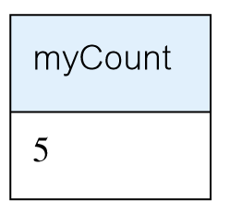
Example 5.13 Use of COUNT(*)
How many properties cost more than £350 per month to rent?
SELECT COUNT(*) AS myCount
  FROM PropertyForRent
  WHERE rent > 350;
© Pearson Education Limited 1995, 2005

Slide 38
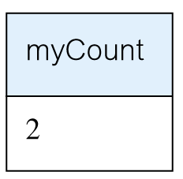
Example 5.14 Use of COUNT(DISTINCT)
How many different properties viewed in May ‘04?
SELECT COUNT(DISTINCT propertyNo) AS myCount
  FROM Viewing
  WHERE viewDate BETWEEN ‘1-May-04’
  AND ‘31-May-04’;
© Pearson Education Limited 1995, 2005

Slide 39
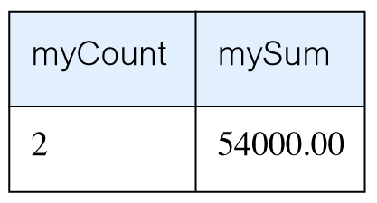
Example 5.15 Use of COUNT and SUM
Find number of Managers and sum of their salaries.
SELECT COUNT(staffNo) AS myCount,
  SUM(salary) AS mySum
  FROM Staff
  WHERE position = ‘Manager’;
© Pearson Education Limited 1995, 2005

Slide 40
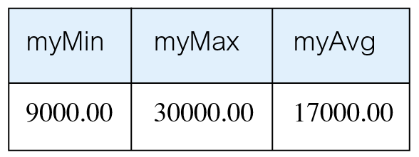
Example 5.16 Use of MIN, MAX, AVG
Find minimum, maximum, and average staff salary.
SELECT MIN(salary) AS myMin,
  MAX(salary) AS myMax,
  AVG(salary) AS myAvg
  FROM Staff;
© Pearson Education Limited 1995, 2005

Slide 41
SELECT Statement - Grouping
Use GROUP BY clause to get sub-totals.
SELECT and GROUP BY closely integrated: each item in SELECT list must be single-valued per group, and SELECT clause may only contain:
  column names
  aggregate functions
  constants
  expression involving combinations of the above.
© Pearson Education Limited 1995, 2005

Slide 42
Example 5.17 Use of GROUP BY
Find number of staff in each branch and their total salaries.
  SELECT branchNo,
  COUNT(staffNo) AS myCount,
    SUM(salary) AS mySum
    FROM Staff
    GROUP BY branchNo
    ORDER BY branchNo;
© Pearson Education Limited 1995, 2005

Slide 43
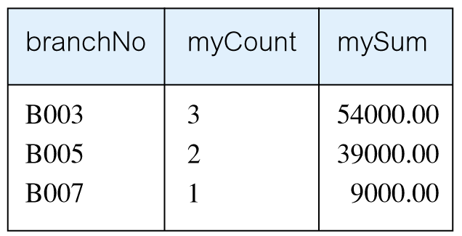
Example 5.17 Use of GROUP BY
© Pearson Education Limited 1995, 2005

Slide 44
Restricted Groupings – HAVING clause
HAVING clause is designed for use with GROUP BY to restrict groups that appear in final result table.
Similar to WHERE, but WHERE filters individual rows whereas HAVING filters groups.
Column names in HAVING clause must also appear in the GROUP BY list or be contained within an aggregate function.
© Pearson Education Limited 1995, 2005

Slide 45
Example 5.18 Use of HAVING
For each branch with more than 1 member of staff, find number of staff in each branch and sum of their salaries.
  SELECT branchNo,
  COUNT(staffNo) AS myCount,
    SUM(salary) AS mySum
    FROM Staff
    GROUP BY branchNo
    HAVING COUNT(staffNo) > 1
    ORDER BY branchNo;
© Pearson Education Limited 1995, 2005

Slide 46
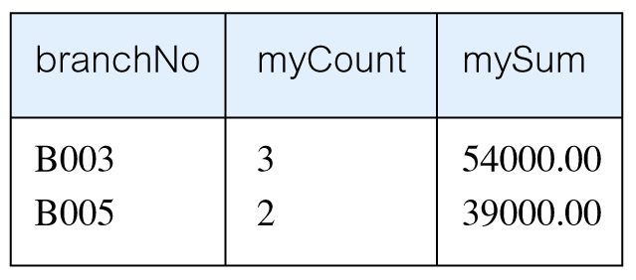
Example 5.18 Use of HAVING
© Pearson Education Limited 1995, 2005

Slide 47
Subqueries
Some SQL statements can have a SELECT embedded within them.
A subselect can be used in WHERE and HAVING clauses of an outer SELECT, where it is called a subquery or nested query.
Subselects may also appear in INSERT, UPDATE, and DELETE statements.
© Pearson Education Limited 1995, 2005

Slide 48
Example 5.19 Subquery with Equality
List staff who work in branch at ‘163 Main St’.
SELECT staffNo, fName, lName, position
  FROM Staff
  WHERE branchNo =
  (SELECT branchNo
  FROM Branch
  WHERE street = ‘163 Main St’);
© Pearson Education Limited 1995, 2005

Slide 49
Example 5.19 Subquery with Equality
Inner SELECT finds branch number for branch at ‘163 Main St’ (‘B003’).
Outer SELECT then retrieves details of all staff who work at this branch.
Outer SELECT then becomes:
  SELECT staffNo, fName, lName, position
    FROM Staff
    WHERE branchNo = ‘B003’;
© Pearson Education Limited 1995, 2005

Slide 50
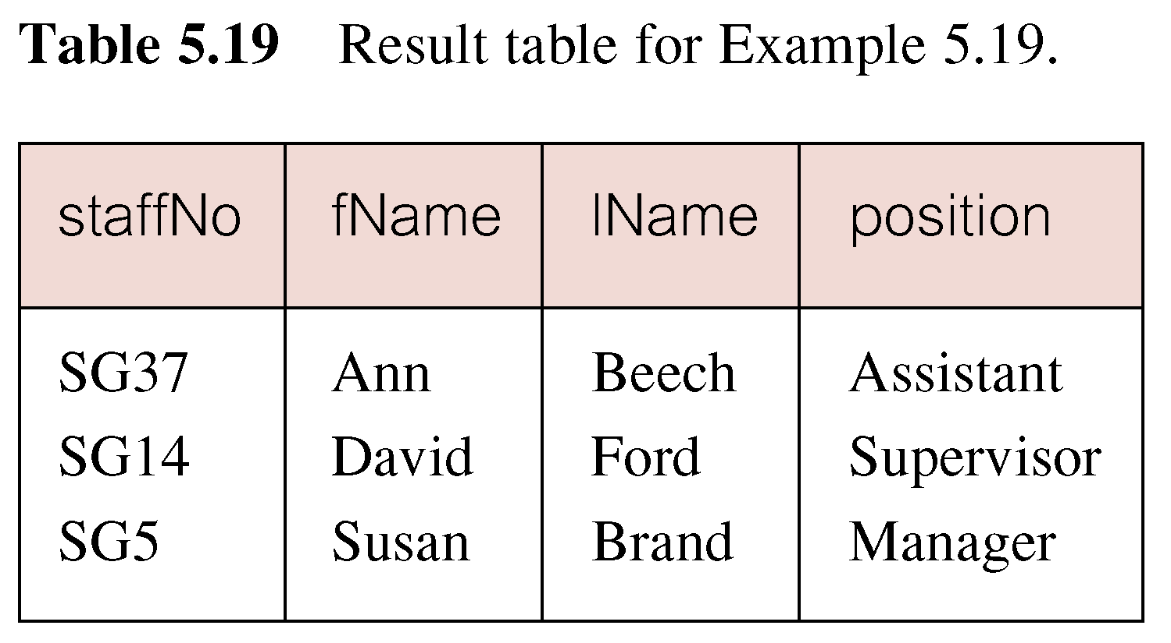
Example 5.19 Subquery with Equality
© Pearson Education Limited 1995, 2005

Slide 51
Example 5.20 Subquery with Aggregate
List all staff whose salary is greater than the average salary, and show by how much.
  SELECT staffNo, fName, lName, position,
  salary – (SELECT AVG(salary) FROM Staff) As SalDiff
  FROM Staff
  WHERE salary >
    (SELECT AVG(salary)
    FROM Staff);
© Pearson Education Limited 1995, 2005

Slide 52
Example 5.20 Subquery with Aggregate
Cannot write ‘WHERE salary > AVG(salary)’
Instead, use subquery to find average salary (17000), and then use outer SELECT to find those staff with salary greater than this:
  SELECT staffNo, fName, lName, position,
  salary – 17000 As salDiff
  FROM Staff
  WHERE salary > 17000;
© Pearson Education Limited 1995, 2005

Slide 53
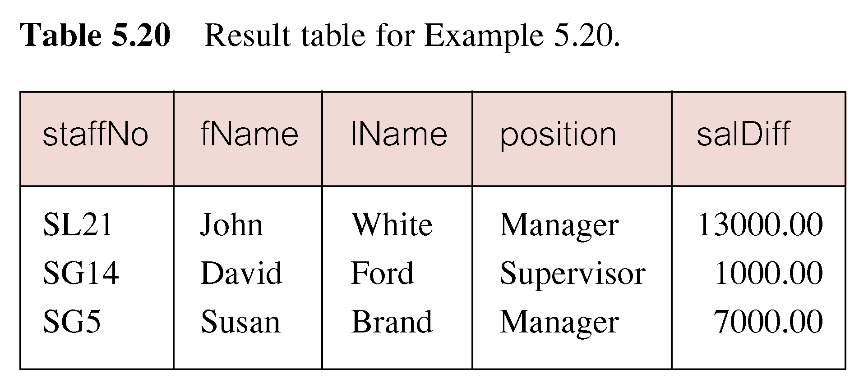
Example 5.20 Subquery with Aggregate
© Pearson Education Limited 1995, 2005

Slide 54
Example 5.21 Nested subquery: use of IN
List properties handled by staff at ‘163 Main St’.
  SELECT propertyNo, street, city, postcode, type, rooms, rent
  FROM PropertyForRent
  WHERE staffNo IN
    (SELECT staffNo
    FROM Staff
    WHERE branchNo =
    (SELECT branchNo
    FROM Branch
    WHERE street = ‘163 Main St’));
© Pearson Education Limited 1995, 2005

Slide 55
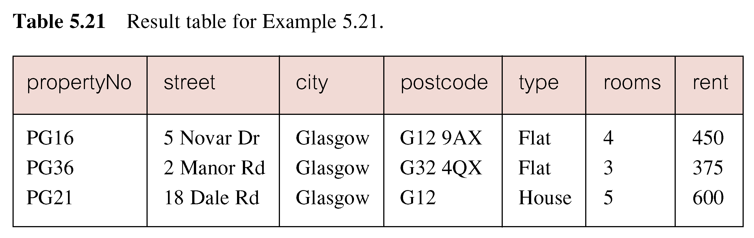
Example 5.21 Nested subquery: use of IN
© Pearson Education Limited 1995, 2005

Slide 56
Multi-Table Queries
Can use subqueries provided result columns come from same table.
If result columns come from more than one table must use a join.
To perform join, include more than one table in FROM clause.
Use comma as separator and typically include WHERE clause to specify join column(s).
© Pearson Education Limited 1995, 2005

Slide 57
Multi-Table Queries
Also possible to use an alias for a table named in FROM clause.
Alias is separated from table name with a space.
Alias can be used to qualify column names when there is ambiguity.
© Pearson Education Limited 1995, 2005

Slide 58
Example 5.24 Simple Join
List names of all clients who have viewed a property along with any comment supplied.
SELECT c.clientNo, fName, lName,
  propertyNo, comment
  FROM Client c, Viewing v
  WHERE c.clientNo = v.clientNo;
© Pearson Education Limited 1995, 2005

Slide 59
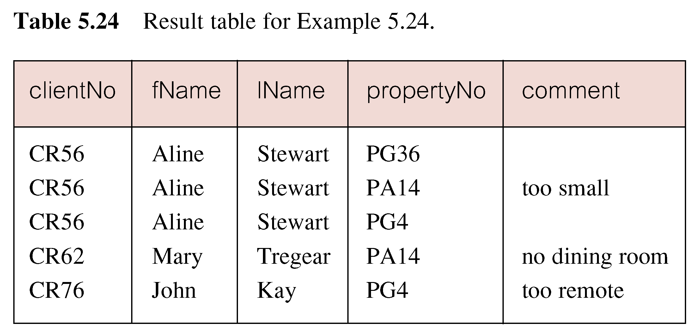
Example 5.24 Simple Join
Only those rows from both tables that have identical values in the clientNo columns (c.clientNo = v.clientNo) are included in result.
Equivalent to equi-join in relational algebra.
© Pearson Education Limited 1995, 2005

Slide 60
Alternative JOIN Constructs
SQL provides alternative ways to specify joins:
FROM Client c JOIN Viewing v ON c.clientNo = v.clientNo
FROM Client JOIN Viewing USING clientNo
FROM Client NATURAL JOIN Viewing
In each case, FROM replaces original FROM and WHERE. However, first produces table with two identical clientNo columns.
© Pearson Education Limited 1995, 2005

Slide 61
Example 5.25 Sorting a join
For each branch, list numbers and names of staff who manage properties, and properties they manage.
SELECT s.branchNo, s.staffNo, fName, lName,
  propertyNo
  FROM Staff s, PropertyForRent p
  WHERE s.staffNo = p.staffNo
  ORDER BY s.branchNo, s.staffNo, propertyNo;
© Pearson Education Limited 1995, 2005

Slide 62
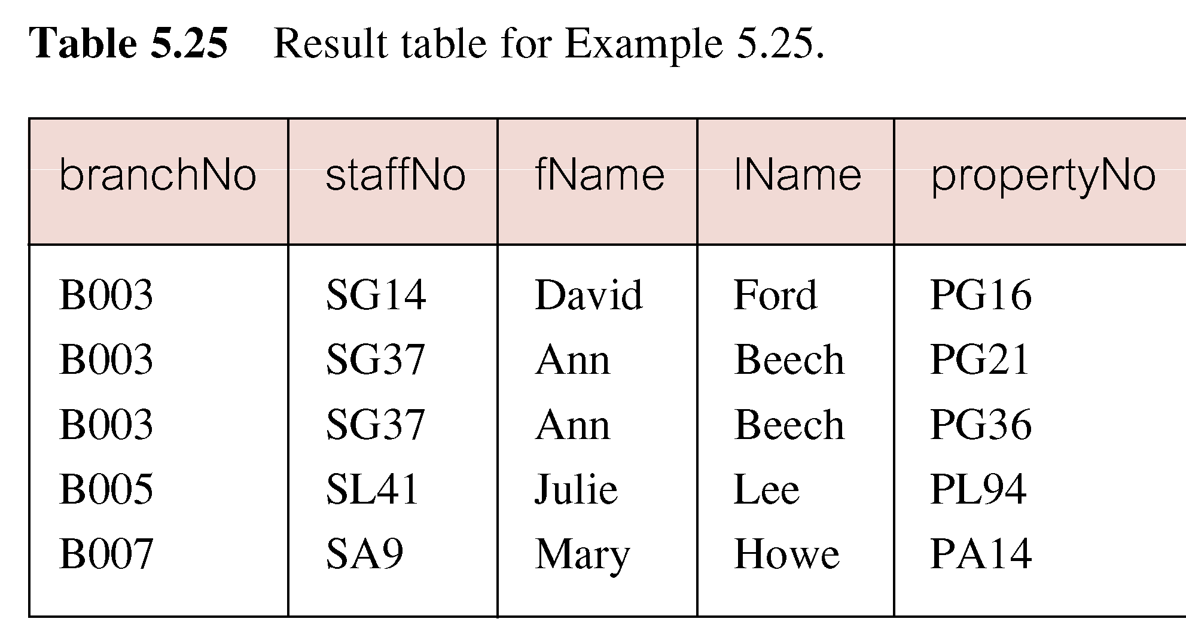
Example 5.25 Sorting a join
© Pearson Education Limited 1995, 2005

Slide 63
Example 5.26 Three Table Join
For each branch, list staff who manage properties, including city in which branch is located and properties they manage.
SELECT b.branchNo, b.city, s.staffNo, fName, lName,
  propertyNo
  FROM Branch b, Staff s, PropertyForRent p
  WHERE b.branchNo = s.branchNo AND
  s.staffNo = p.staffNo
  ORDER BY b.branchNo, s.staffNo, propertyNo;
© Pearson Education Limited 1995, 2005

Slide 64
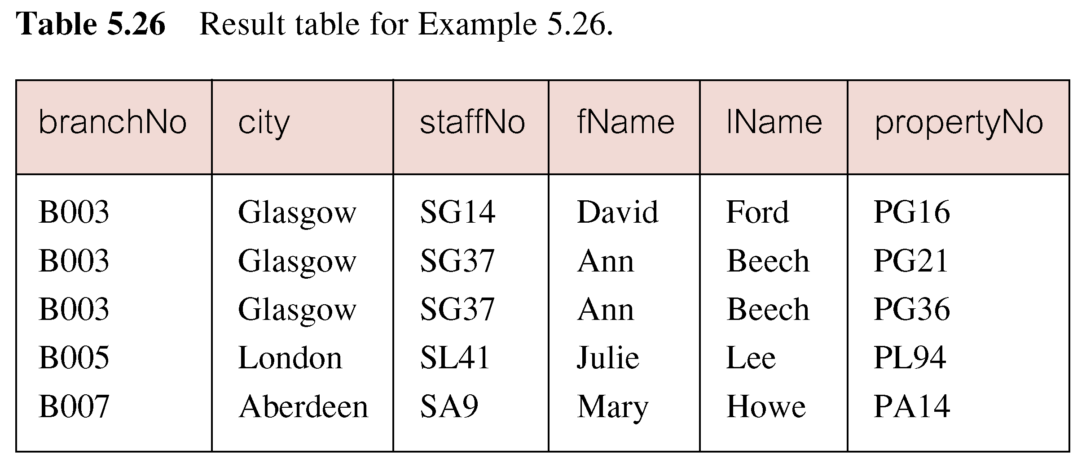
Example 5.26 Three Table Join
Alternative formulation for FROM and WHERE:
  FROM (Branch b JOIN Staff s USING branchNo) AS
  bs JOIN PropertyForRent p USING staffNo
© Pearson Education Limited 1995, 2005

Slide 65
Example 5.27 Multiple Grouping Columns
Find number of properties handled by each staff member.
SELECT s.branchNo, s.staffNo, COUNT(*) AS myCount
  FROM Staff s, PropertyForRent p
  WHERE s.staffNo = p.staffNo
  GROUP BY s.branchNo, s.staffNo
  ORDER BY s.branchNo, s.staffNo;
© Pearson Education Limited 1995, 2005

Slide 66
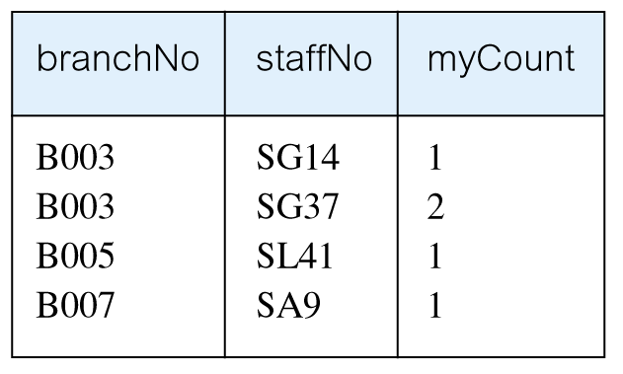
Example 5.27 Multiple Grouping Columns
© Pearson Education Limited 1995, 2005

Slide 67
Computing a Join
Procedure for generating results of a join are:
1. Form Cartesian product of the tables named in FROM clause.
2. If there is a WHERE clause, apply the search condition to each row of the product table, retaining those rows that satisfy the condition.
3. For each remaining row, determine value of each item in SELECT list to produce a single row in result table.
© Pearson Education Limited 1995, 2005

Slide 68
Computing a Join
4. If DISTINCT has been specified, eliminate any duplicate rows from the result table.
5. If there is an ORDER BY clause, sort result table as required.
SQL provides special format of SELECT for Cartesian product:
  SELECT [DISTINCT | ALL] {* | columnList}
  FROM Table1 CROSS JOIN Table2
© Pearson Education Limited 1995, 2005

Slide 69
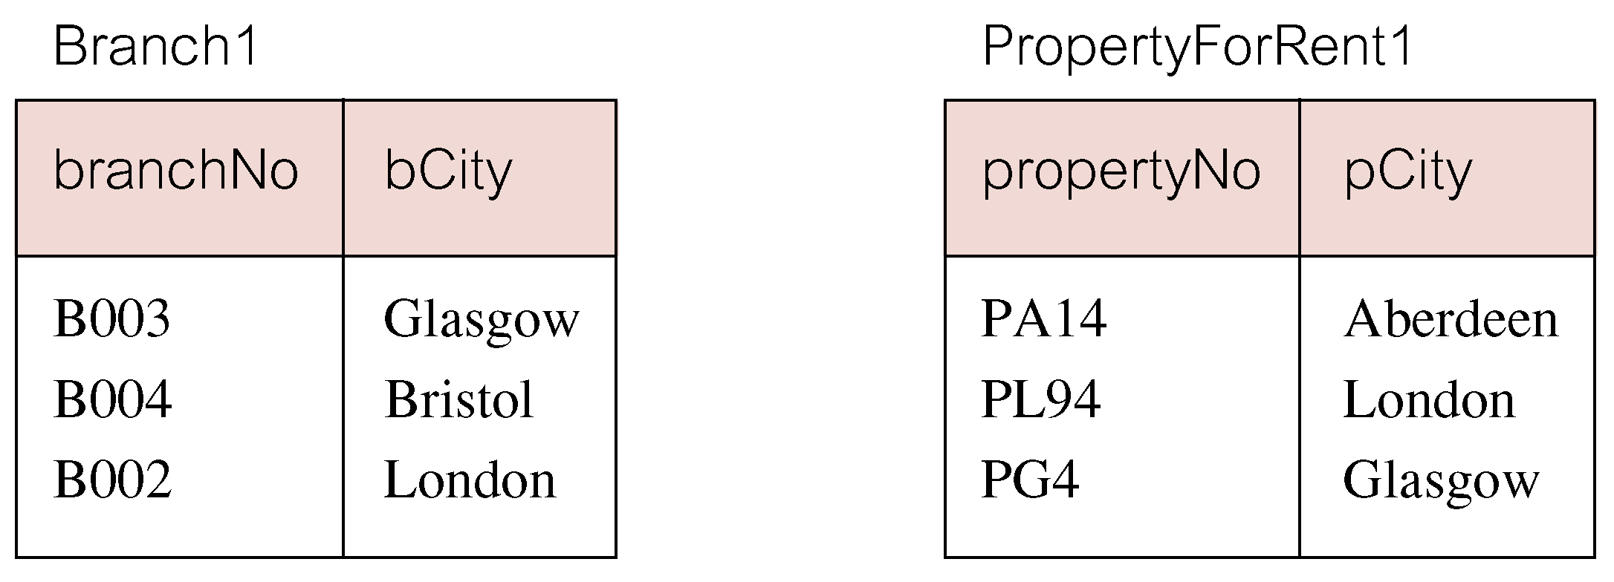
Outer Joins
If one row of a joined table is unmatched, row is omitted from result table.
Outer join operations retain rows that do not satisfy the join condition.
Consider following tables:
© Pearson Education Limited 1995, 2005

Slide 70
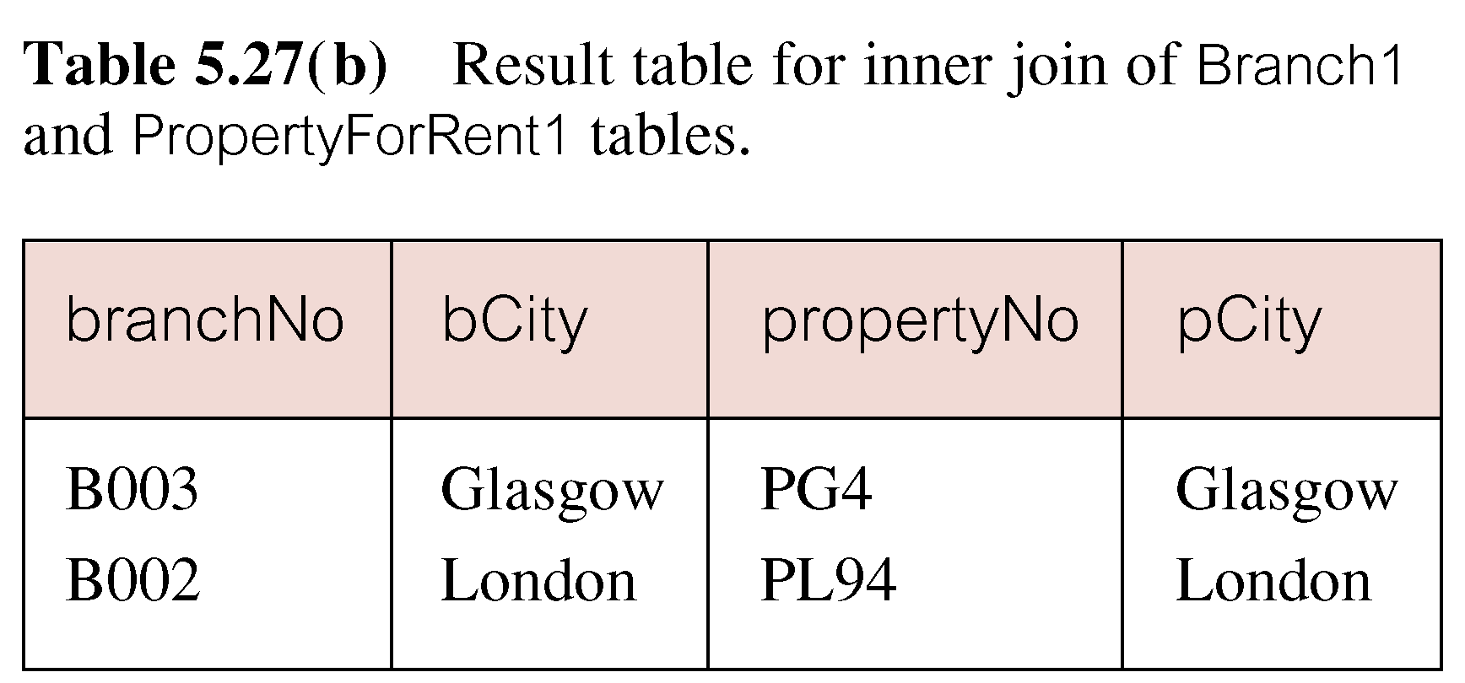
Outer Joins
The (inner) join of these two tables:
  SELECT b.*, p.*
    FROM Branch1 b, PropertyForRent1 p
    WHERE b.bCity = p.pCity;
© Pearson Education Limited 1995, 2005

Slide 71
Outer Joins
Result table has two rows where cities are same.
There are no rows corresponding to branches in Bristol and Aberdeen.
To include unmatched rows in result table, use an Outer join.
© Pearson Education Limited 1995, 2005

Slide 72
Example 5.28 Left Outer Join
List branches and properties that are in same city along with any unmatched branches.
SELECT b.*, p.*
  FROM Branch1 b LEFT JOIN
  PropertyForRent1 p ON b.bCity = p.pCity;
© Pearson Education Limited 1995, 2005

Slide 73
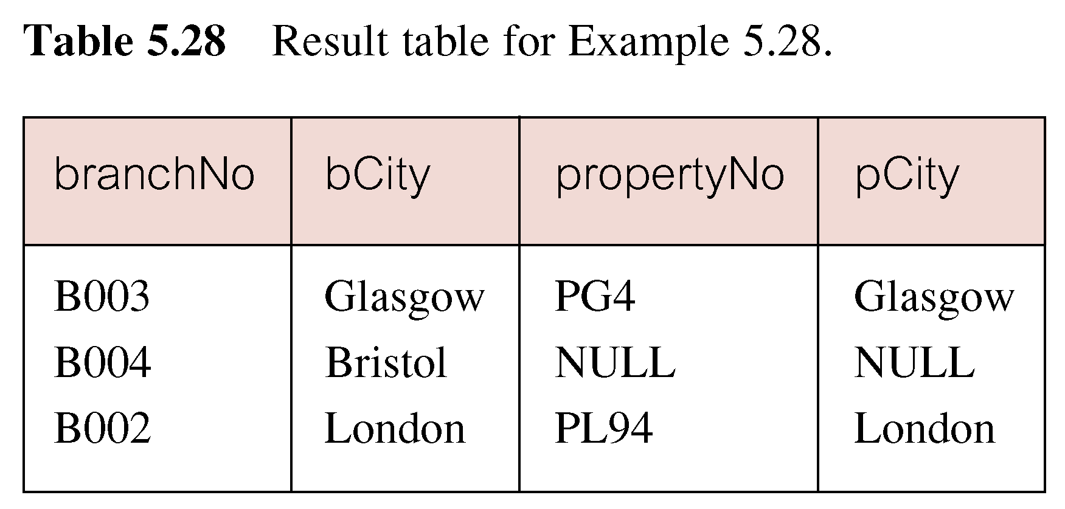
Example 5.28 Left Outer Join
Includes those rows of first (left) table unmatched with rows from second (right) table.
Columns from second table are filled with NULLs.
© Pearson Education Limited 1995, 2005

Slide 74
Example 5.29 Right Outer Join
List branches and properties in same city and any unmatched properties.
SELECT b.*, p.*
  FROM Branch1 b RIGHT JOIN
  PropertyForRent1 p ON b.bCity = p.pCity;
© Pearson Education Limited 1995, 2005

Slide 75
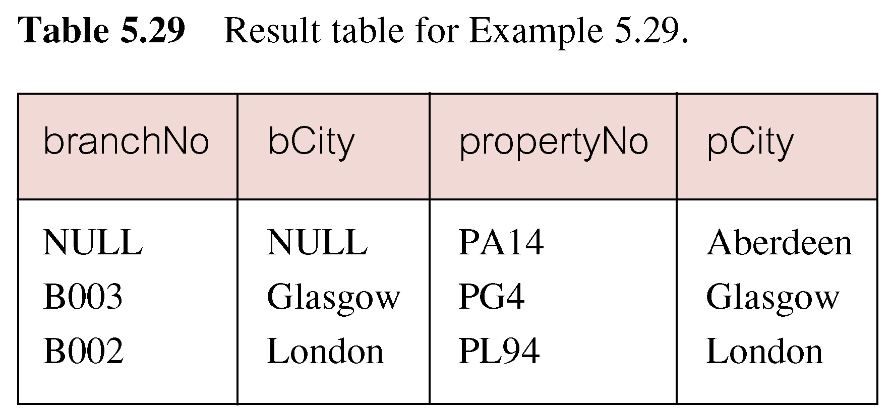
Example 5.29 Right Outer Join
Right Outer join includes those rows of second (right) table that are unmatched with rows from first (left) table.
Columns from first table are filled with NULLs.
© Pearson Education Limited 1995, 2005

Slide 76
Example 5.30 Full Outer Join
List branches and properties in same city and any unmatched branches or properties.
SELECT b.*, p.*
  FROM Branch1 b FULL JOIN
  PropertyForRent1 p ON b.bCity = p.pCity;
© Pearson Education Limited 1995, 2005

Slide 77
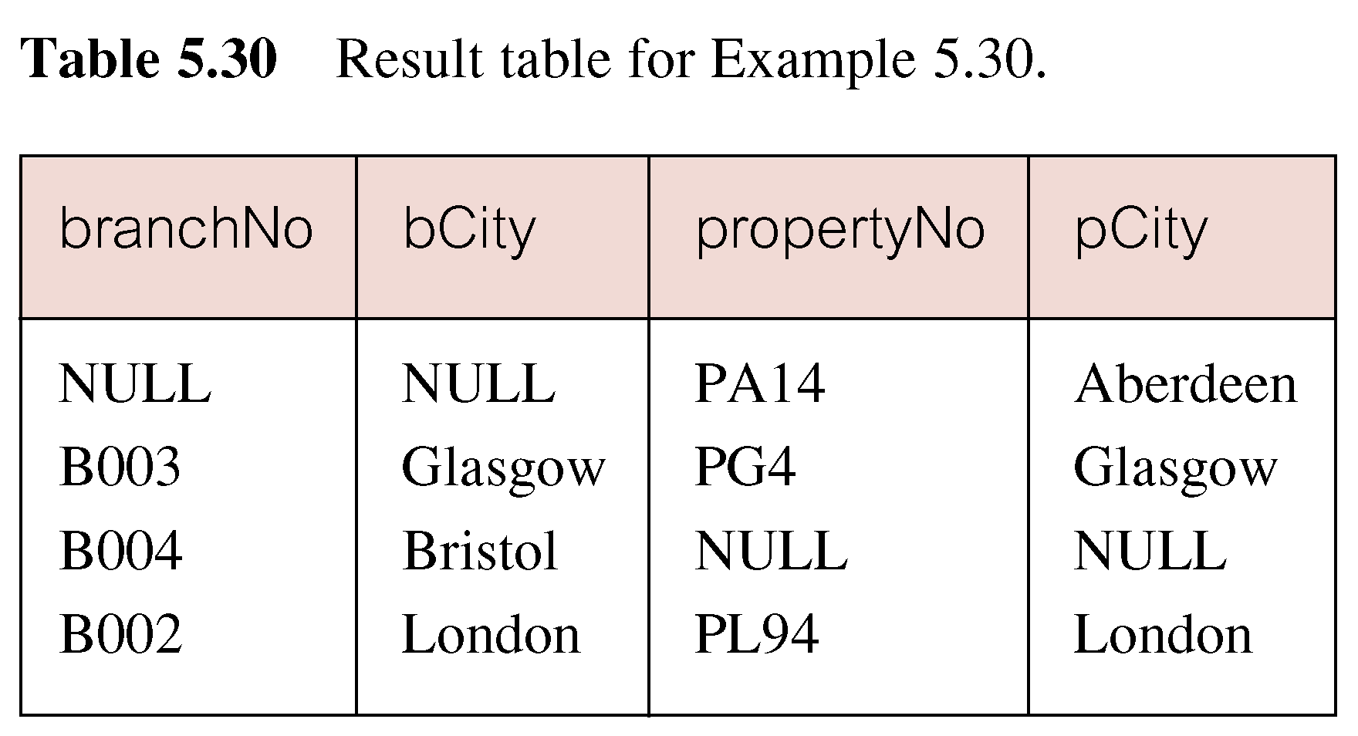
Example 5.30 Full Outer Join
Includes rows that are unmatched in both tables.
Unmatched columns are filled with NULLs.
© Pearson Education Limited 1995, 2005

Slide 78
Example 5.32 Use of UNION
List all cities where there is either a branch office or a property.
(SELECT city
  FROM Branch
  WHERE city IS NOT NULL) UNION
  (SELECT city
  FROM PropertyForRent
  WHERE city IS NOT NULL);
© Pearson Education Limited 1995, 2005

Slide 79
Example 5.32 Use of UNION
Or
  (SELECT *
  FROM Branch
  WHERE city IS NOT NULL)
  UNION CORRESPONDING BY city
  (SELECT *
  FROM PropertyForRent
  WHERE city IS NOT NULL);
© Pearson Education Limited 1995, 2005

Slide 80
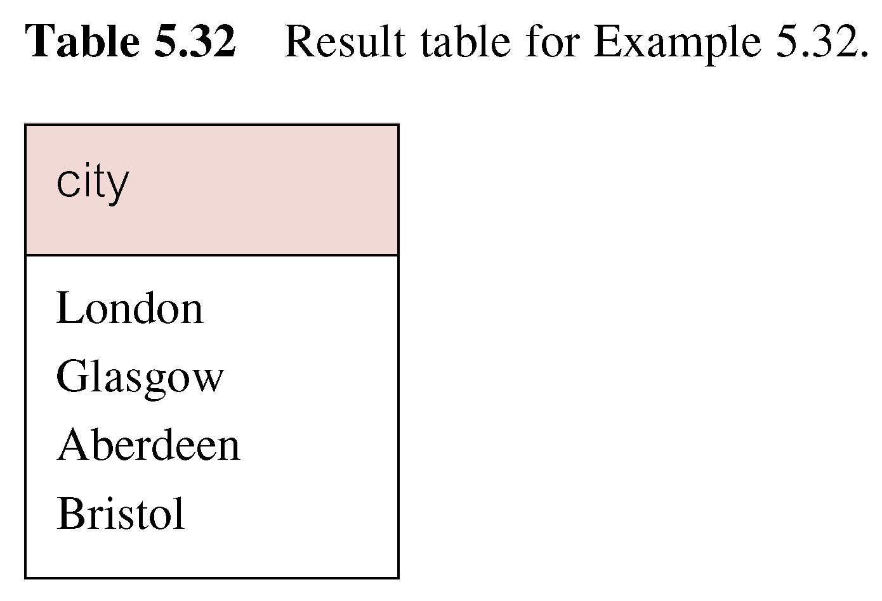
Example 5.32 Use of UNION
Produces result tables from both queries and merges both tables together.
© Pearson Education Limited 1995, 2005

Slide 81
INSERT
INSERT INTO TableName [ (columnList) ]
  VALUES (dataValueList)
columnList is optional; if omitted, SQL assumes a list of all columns in their original CREATE TABLE order.
Any columns omitted must have been declared as NULL when table was created, unless DEFAULT was specified when creating column.
© Pearson Education Limited 1995, 2005

Slide 82
INSERT
dataValueList must match columnList as follows:
  number of items in each list must be same;
  must be direct correspondence in position of items in two lists;
  data type of each item in dataValueList must be compatible with data type of corresponding column.
© Pearson Education Limited 1995, 2005

Slide 83
Example 5.35 INSERT … VALUES
Insert a new row into Staff table supplying data for all columns.
INSERT INTO Staff
  VALUES (‘SG16’, ‘Alan’, ‘Brown’, ‘Assistant’, ‘M’, Date‘1957-05-25’, 8300, ‘B003’);
© Pearson Education Limited 1995, 2005

Slide 84
Example 5.36 INSERT using Defaults
Insert a new row into Staff table supplying data for all mandatory columns.
INSERT INTO Staff (staffNo, fName, lName,
  position, salary, branchNo)
  VALUES (‘SG44’, ‘Anne’, ‘Jones’,
  ‘Assistant’, 8100, ‘B003’);
Or
  INSERT INTO Staff
  VALUES (‘SG44’, ‘Anne’, ‘Jones’, ‘Assistant’, NULL,
  NULL, 8100, ‘B003’);
© Pearson Education Limited 1995, 2005

Slide 85
INSERT … SELECT
Second form of INSERT allows multiple rows to be copied from one or more tables to another:
INSERT INTO TableName [ (columnList) ]
  SELECT ...
© Pearson Education Limited 1995, 2005

Slide 86
Example 5.37 INSERT … SELECT
Assume there is a table StaffPropCount that contains names of staff and number of properties they manage:
  StaffPropCount(staffNo, fName, lName, propCnt)
Populate StaffPropCount using Staff and PropertyForRent tables.
© Pearson Education Limited 1995, 2005

Slide 87
Example 5.37 INSERT … SELECT
  INSERT INTO StaffPropCount
  (SELECT s.staffNo, fName, lName, COUNT(*)
  FROM Staff s, PropertyForRent p
  WHERE s.staffNo = p.staffNo
  GROUP BY s.staffNo, fName, lName)
  UNION
  (SELECT staffNo, fName, lName, 0
  FROM Staff
  WHERE staffNo NOT IN
  (SELECT DISTINCT staffNo
  FROM PropertyForRent));
© Pearson Education Limited 1995, 2005

Slide 88
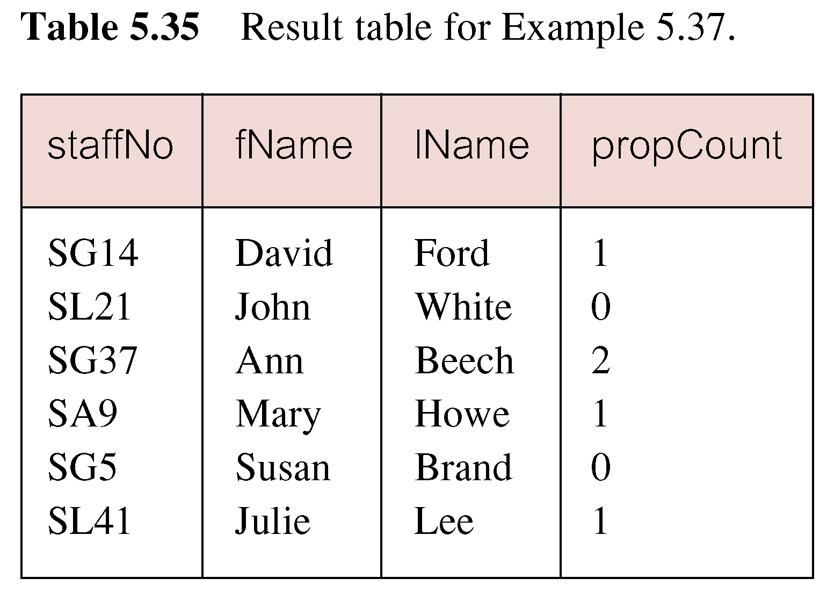
Example 5.37 INSERT … SELECT
If second part of UNION is omitted, excludes those staff who currently do not manage any properties.
© Pearson Education Limited 1995, 2005

Slide 89
UPDATE
  UPDATE TableName
  SET columnName1 = dataValue1
  [, columnName2 = dataValue2...]
  [WHERE searchCondition]
TableName can be name of a base table or an updatable view.
SET clause specifies names of one or more columns that are to be updated.
© Pearson Education Limited 1995, 2005

Slide 90
UPDATE
WHERE clause is optional:
  if omitted, named columns are updated for all rows in table;
  if specified, only those rows that satisfy searchCondition are updated.
New dataValue(s) must be compatible with data type for corresponding column.
© Pearson Education Limited 1995, 2005

Slide 91
Example 5.38/39 UPDATE All Rows
Give all staff a 3% pay increase.
UPDATE Staff
  SET salary = salary*1.03;
Give all Managers a 5% pay increase.
UPDATE Staff
  SET salary = salary*1.05
  WHERE position = ‘Manager’;
© Pearson Education Limited 1995, 2005

Slide 92
Example 5.40 UPDATE Multiple Columns
Promote David Ford (staffNo=‘SG14’) to Manager and change his salary to £18,000.
UPDATE Staff
  SET position = ‘Manager’, salary = 18000
  WHERE staffNo = ‘SG14’;
© Pearson Education Limited 1995, 2005

Slide 93
DELETE
  DELETE FROM TableName
  [WHERE searchCondition]
TableName can be name of a base table or an updatable view.
searchCondition is optional; if omitted, all rows are deleted from table. This does not delete table. If search_condition is specified, only those rows that satisfy condition are deleted.
© Pearson Education Limited 1995, 2005

Slide 94
Example 5.41/42 DELETE Specific Rows
Delete all viewings that relate to property PG4.
DELETE FROM Viewing
  WHERE propertyNo = ‘PG4’;
Delete all records from the Viewing table.
  DELETE FROM Viewing;
© Pearson Education Limited 1995, 2005

